Slide 1
AI Networking script
April, 2023

Slide 2
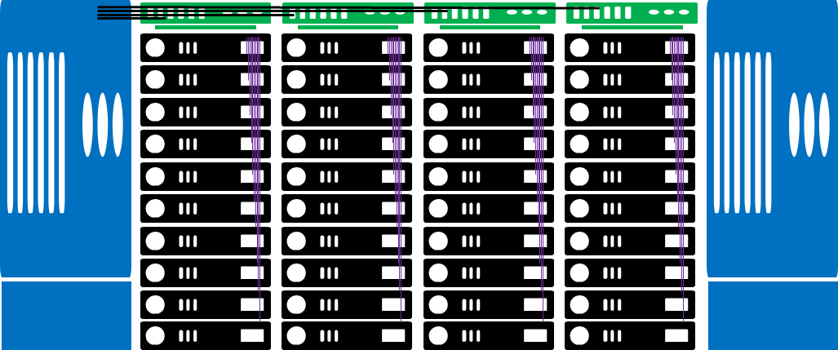
Animation:
(1) Build the servers (black)
(2) Add the leaves/ToR (green) and purple lines
(3) Add the spine/chassis (blue) and black lines, add more rows in the background
(4) Show traffic going from different servers to the Internet and back – show pop ups
(5) Add Clos box
Internet
Clos
Callouts:
North-South traffic
Single server per job/query – minor back-end traffic
Narration:
(1) This is a datacenter. It has servers with CPUs and GPUs, that
(2) at each rack connect to leaf, Top of Rack switches, which
(3) connect to a centralized, or spine, chassis-based switch – and connects to the internet
(4) Where most of the queries arrive from, so not a lot of back-end traffic
(5) This Clos architecture is the best one for datacenters

Slide 3
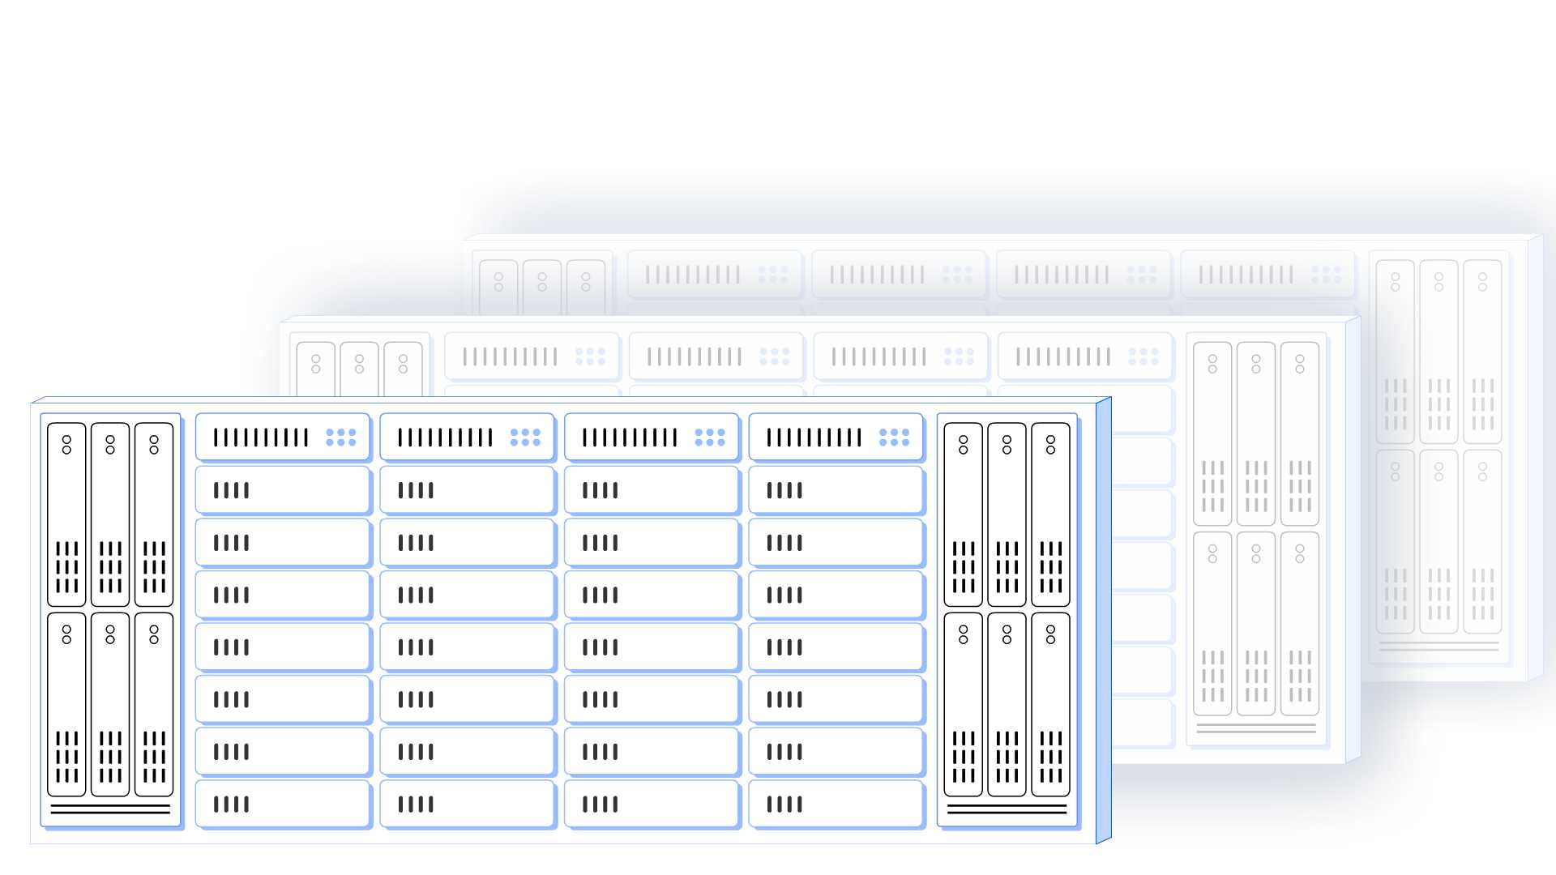

Slide 4
(1) Transision from traffic to the internet to (mostly) internal traffic - Packets flow from servers to ToR and back to servers at the same rack
(2) Packet flow between racks, going from ToR to chassis, back to ToR and to the destination server (see PPT animation)
(3) Add the JCT gauge, with slow as good (green) and high as red) show packets delaying and dropping, and as result show processes stuck (stop sign) and JCT gauge rising
Clos
Not predictable
Not lossless
Internet
Callouts:
East-west traffic
Multiple servers per job
Mix and match processing
(1) But when it comes to AI clusters, which run compute workloads in parallel on multiple GPUs, those servers need back-end communication, east-west, with other servers in the same rack, and
(2) in other racks, with different networking requirements.
(3) High bandwidth, no jitter, lossless and universal connectivity are a must as packet loss or jitter severely degrades GPU utilization, and drops
(4) Job Completion Time, or JCT. By nature, the non-scheduled 3-hop, or higher, Ethernet Clos architecture
(5) is not predictable, nor is it lossless - thus not suitable for AI networking
JCT gauge

Slide 5
Proprietary
Vendor lock
Gateway required
Internet
You can use a proprietary networking solution, but it will require an Ethernet gateway to the north, and lock you to a GPU vendor…
JCT gauge

Slide 6
Animation:
Transition from previous slide – drop the ToR and move the cables
Move the JCT back to green
Show blinking red around the chassis and servers that cannot be added
Highlight the cables and turn them into a cable spaghetti
Chassis
Cannot scale
Operational hazard
Remove ToR
One unified network as fabric
Chassis
Connecting to all servers
redundancy
(1) Ideally, you could flatten the networking infrastructure, so that it would improve application performance just by taking one hop between any two servers
(2) but this requires the world's largest chassis
(3) and cabling for it would be an operational nightmare
(4)​
JCT gauge

Slide 7
Transition from previous slide – replace chassis with DDC cluster, add racks with servers
DDC
NCF
Connecting all NCP
. . . .
. . . .
NCP
connecting to all servers
(1) However, this could be solved with DriveNets Network Cloud disaggregated distributed architecture - this is the world's largest chassis - it is a distributed architecture which solves any scale limitation of the metal enclosure
JCT gauge

Slide 8
Trainstion from previous slide – move NCPs to ToR
Untangle and simplify cabling
Show frames going to the ToR, breaking into cells that run to the NCF and reframed back at the target NCP
Take the JCT gauge to the green extreme
DDC
NCP
connecting to all servers
NCF
Connecting all NCP
. . . .
. . . .
. . . .
. . . .
(1) ...and with the ability to move parts of this Distributed Disaggregated Chassis to the top of each rack,
(2) this eliminates the cabling issue.
(3) Thanks to a cell-based fabric, this maintains high-availability, low-jitter, single Ethernet hops between all servers, which eventually leads
(4) to the best JCT figures for an AI cluster
And it’s the same, familiar, Clos topology, you are used to work with
JCT gauge

Slide 9
Clos
Not predictable
Not lossless
Proprietary
Vendor lock
Gateway required
Chassis
Cannot scale
Operational hazard
DDC
DDC is the only suitable solution for AI networking and if you go for DDC
You better choose one that works

Slide 10
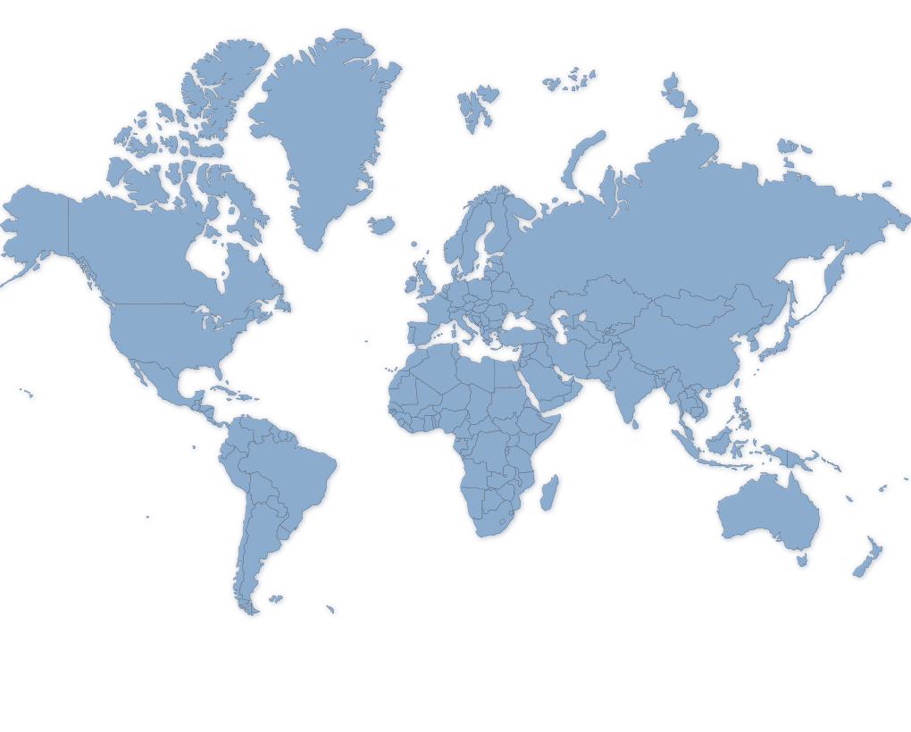
Zoom out, put on a globe
(1) DriveNets Network Cloud solution is deployed in multiple high scale networks around the world, able to support capacities of up to 691Tbps (Terabytes per second)

Slide 11
Zoom in – show the classic architecture
AI networking - switching
Carrier grade routing
Services APIs
Network Cloud Hypervisor
Hardware APIs
(1) And it is a truly disaggregated architecture, both hardware and ASIC agnostic

Slide 12
DriveNets DDC-AI 3.0 Your Benefits
Architectural Flexibility
Performance at Scale
Trusted Solution
Seamless Internet Connectivity
Well-Known Protocol - 600M Ethernet Ports Per Year.
Support Diverse Apps
Up to 32K GPUs (800G) per Cluster
Cell-based fabric
10-30% improved JCT performance: >100% RoI
Based on a certified OCP concept
Powering the World’s Largest DDC Network- >52% of AT&T
GPU, ASIC & ODM agnostic
Performance Proven by US\CN Hyperscalers
Notes:
Relatively to J2C+ based cluster @ ~100Tb

Slide 13
